Slide 1
INFOSYS SPRINGBOARD VIRTUAL INTERNSHIP 7.0
CivicPulse
Smart Governance Platform for Administrative Operations
with Citizen Service Assistance
A role-based digital governance platform connecting citizens, administrators, and department officers through complaint management, automated priority scoring, department mapping, dashboards, notifications, and feedback.
PRESENTED BY
Team D — Riya, Shamiha, Sanjana, Shubhdeep
MENTOR
Ragul S
Infosys Mentor — CivicPulse Smart Governance Management Platform

Slide 2
PLATFORM OVERVIEW
What CivicPulse brings together
CivicPulse is an end-to-end smart governance platform that streamlines how citizens raise civic issues and how administrations respond to them. It combines a citizen-facing portal, AI-assisted complaint intelligence, automated escalation, and department-level accountability into one connected system — built for scale on a modern Java enterprise stack.
ON THIS DECK
Core platform modules (8)
Unique & future-ready features
Java technology stack
8
4
24/7
100%
System workflow & data model
Core Modules
Smart / AI Capabilities
Citizen Access
Java Enterprise Stack
Delivered project impact
Designed for municipalities, urban local bodies, and public-service departments seeking a transparent, responsive citizen-engagement system.
CivicPulse | Smart Governance Management Platform
2

Slide 3




PROBLEM STATEMENT
Why the platform is needed
CivicPulse is a full-stack governance platform that connects citizens, administrators, and department officers through a centralized complaint-management workflow — covering registration, automated priority scoring, department assignment, status tracking, dashboards, notifications, reporting, and citizen feedback.
Fragmented Complaint Reporting
Limited Status Visibility
Manual Department Assignment
Limited Administrative Insights
Civic issues arrive through scattered, disconnected channels with no central record.
Citizens have little insight into where a complaint stands after it's filed.
Routing complaints to the right department relies on manual, error-prone handling.
Officials lack consolidated data to monitor performance and spot patterns.
THE CORE GAPS
No centralized complaint-management platform • Limited visibility into complaint status • Limited department-level monitoring and accountability. CivicPulse closes these gaps with automated priority classification and department-wise monitoring.
CivicPulse | Smart Governance Management Platform
3

Slide 4




OBJECTIVES
What CivicPulse is designed to achieve
CivicPulse aims to give every stakeholder — citizen, official, and administrator — a faster, more transparent way to raise, manage, and resolve civic issues, replacing manual paperwork with a connected digital workflow.
Simplify Reporting
Enable Tracking
Speed Up Resolution
Improve Transparency
Give citizens a clear, guided path to raise civic issues.
Let every stakeholder follow a complaint from filing to closure.
Route and prioritize issues automatically to cut response time.
Surface status, priority, and progress at every stage.
SUCCESS LOOKS LIKE
Citizens track complaints end-to-end • Officials resolve issues faster • Admins see system-wide analytics — built for municipalities and public-service departments seeking a transparent, responsive citizen-engagement system.
CivicPulse | Smart Governance Management Platform
4

Slide 5




COMPLAINT LIFECYCLE
From citizen report to resolution
Every complaint moves through a structured, auditable journey — from the moment a citizen raises an issue to the moment it is resolved and rated — keeping ownership and timelines clear at every step.
1
2
3
4
Citizen Registers Issue
Auto-Routed to Department
Official Resolves & Updates
Citizen Tracks & Rates
BUILT-IN ACCOUNTABILITY
SLA timers trigger escalation
Status updates in real time
Feedback closes the loop
Designed so no complaint is ever lost or left unowned between departments.
CivicPulse | Smart Governance Management Platform
5

Slide 6
HOME PAGE DASHBOARD
Live issue counts, right on the home page
A dashboard on the home page shows how many issues have been registered, resolved, and are still pending or in progress — giving instant visibility into platform activity for citizens and officials alike, no login required.
120
80
HOW IT WORKS
Registered
Resolved
One API aggregates status counts
React renders live stat cards
25
15
Updates automatically as issues change
A simple, high-impact addition that makes the platform's activity visible at a glance — a team highlight of the citizen module.
Pending
In Progress
CivicPulse | Smart Governance Management Platform
6

Slide 7




CORE PLATFORM MODULES
Citizen services and complaint-management foundations (1 of 2)
Citizen Portal
Complaint Management
Web portal where citizens register complaints, track complaint status, view notifications, manage their profile, and submit feedback.
Centralized system to create, view, update, assign, filter, track, and resolve complaints throughout their lifecycle.
Automated Priority Scoring
Department Officer Module
Rule-based scoring evaluates complaint category, critical/high/medium keywords, and repeated reports to calculate a priority score.
Rule-based engine that automatically escalates unresolved or overdue complaints up the chain of authority based on SLA timers.
CivicPulse | Smart Governance Management Platform
7

Slide 8




CORE PLATFORM MODULES
Administration, notifications, and department operations (2 of 2)
Admin Dashboard
Notification & Feedback
Administrative dashboard for monitoring complaints, statuses, priorities, department activity, reports, and overall platform performance.
In-platform notifications keep citizens informed about complaint updates; feedback supports 1–5 ratings, comments, history, and analysis.
Priority Analysis & Distribution
Department-wise Management
Displays High, Medium, and Low priority complaints using calculated priority scores, priority reasons, and department-wise distribution.
Maps complaint categories to standardized departments and provides department-wise complaint monitoring and workload visibility.
CivicPulse | Smart Governance Management Platform
8

Slide 9







SYSTEM WORKFLOW
From registration to resolution and feedback
1
2
3
4
Submit
Validate
Priority Scoring
Assign
Citizen registers a complaint through the web portal.
System validates details and stores the complaint in the database.
Rule-based scoring classifies complaints as High, Medium, or Low.
Complaint category is mapped to the standardized department.
5
6
7
8
Track
Notify
Resolve
Feedback
Citizens and officials track status through their dashboards.
Citizens receive in-platform notifications on status updates.
Department officers update status and resolve the complaint.
Citizen submits a 1–5 rating and comments after resolution.
CivicPulse | Smart Governance Management Platform
9

Slide 10











JAVA TECHNOLOGY STACK
Layered enterprise architecture powering CivicPulse
Frontend
Why This Stack?
(Presentation Layer)
React 19
Vite 8
React Router
Lucide React
User Interface & Experience
Modern UI library for building interfaces
Fast development and build tool
Client-side routing and navigation
Modern icon library for clean UI
Modern and widely used technologies
Backend
(Application Layer)
Spring Boot 3.5.5
Java 17
REST APIs
Validation
Scalable and maintainable architecture
Business Logic & APIs
REST API development and application framework
Programming language (LTS)
Provide data and services to frontend
Input validation and error handling
Secure and role-based access
Security Layer
Spring Security
JWT
BCrypt
Role-based Access
Efficient development and testing
Authentication & Authorization
Secure application with authentication
Token-based authentication
Password hashing and security
Different access for Citizen, Admin, Officer
Data Layer
MySQL
Spring Data JPA
Hibernate
“Empowering better governance through technology”
Database & ORM
Relational database for data storage
Database operations and repositories
Object-relational mapping (ORM)
Build & Testing
Maven
JUnit
Spring Boot Test
Development & Quality
Build and dependency management
Unit and integration testing
Testing support for Spring Boot
CivicPulse | Smart Governance Management Platform
10

Slide 11
ENTITY-RELATIONSHIP DIAGRAM
Conceptual data model behind the CivicPulse schema
PK Primary Key FK Foreign Key 1 — 1 One to One 1 — M One to Many
USER
CITIZEN
CATEGORY
NOTIFICATION
PK
user_id
1—1
PK
citizen_id
PK
category_id
PK
notification_id
– username
FK
user_id
– category_name
FK
citizen_id
– password
– name
– description
– message
– role
– email
1—M
– is_read
1—1
– phone
COMPLAINT
– created_at
– address
1—M
DEPARTMENT OFFICER
1—M
PK
complaint_id
FEEDBACK
PK
officer_id
FK
citizen_id
FK
user_id
DEPARTMENT
FK
category_id
PK
feedback_id
department_id
M—1
FK
department_id
FK
complaint_id
FK
PK
department_id
– title
FK
citizen_id
– name
– code
– rating
– email
– name
– description
– role
– description
1—M
– location
– comment
– priority
– created_at
– priority_score
1—M
– severity
– affected_people
– is_public_location
– status
– created_at
Straight connectors show primary → foreign-key relationships between core CivicPulse entities.
CivicPulse | Smart Governance Management Platform
11

Slide 12
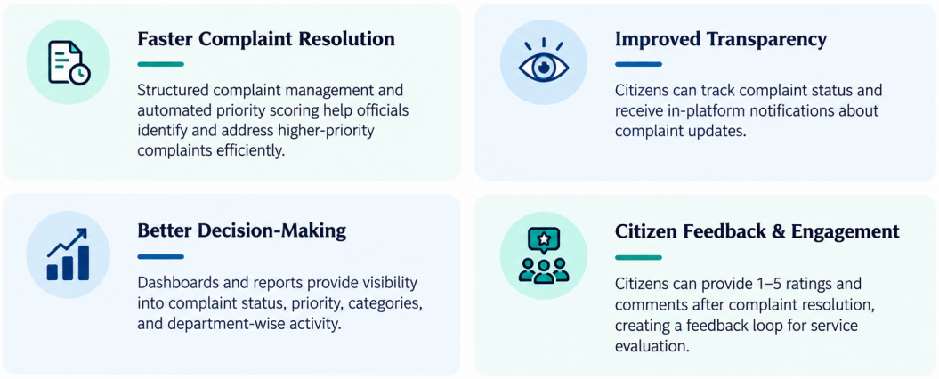
PROJECT IMPACT
Key benefits delivered by the implemented platform
CivicPulse | Smart Governance Management Platform
12

Slide 13




FUTURE ENHANCEMENTS
Where CivicPulse goes from here
Beyond the current implementation, these enhancements would extend CivicPulse's reach, accessibility, and predictive power for municipalities and public-service departments.
AI Chatbot
Multi-language Support
Voice-Enabled Filing
Predictive Analytics
A conversational assistant to guide citizens, answer FAQs, and assist with complaint registration using natural language.
A multilingual interface to make civic services accessible to citizens across different regional languages.
Voice-to-text complaint registration to improve accessibility for citizens with limited typing ability.
Analytics to forecast complaint trends, identify hotspots, and support proactive administrative decisions.
Each enhancement builds on CivicPulse's existing complaint-management core, extending it toward a smarter, more accessible governance experience.
CivicPulse | Smart Governance Management Platform
13

Slide 14
CONCLUSION
Building responsive, transparent governance
CivicPulse brings citizens, department officers, and administrators onto one connected platform — turning fragmented, manual complaint handling into a transparent, trackable, and accountable digital workflow, from registration to resolution and feedback.
8 core modules covering the full citizen-to-resolution journey
Automated priority scoring and department-wise accountability
A clear roadmap — AI chatbot, multilingual access, predictive insights
Thank you.
Team D — Riya, Shamiha, Sanjana, Shubhdeep
Mentor: Ragul S — Infosys Mentor
CivicPulse | Smart Governance Management Platform
14

